Slide 1
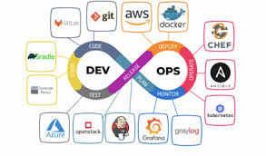
Devops tools

Slide 2
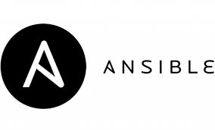
Ansible is a leading DevOps tool. Ansible is an open-source IT engine that automates application deployment, cloud provisioning, intra service orchestration, and other IT tools.
It makes it easier for DevOps teams to scale automation and speed up productivity.

Slide 3
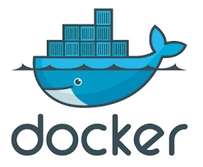
Docker is a high-end DevOps tool that allows building, ship, and run distributed applications on multiple systems.
It also helps to assemble the apps quickly from the components, and it is typically suitable for container management.

Slide 4
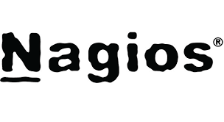
Nagios is one of the more useful tools for DevOps.
It can determine the errors and rectify them with the help of network, infrastructure, server, and log monitoring systems.

Slide 5
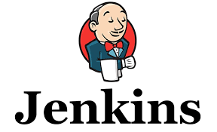
Jenkins is a DevOps tool for monitoring the execution of repeated tasks. Jenkins is a software that allows continuous integration.
Jenkins will be installed on a server where the central build will take place.
It helps to integrate project changes more efficiently by finding the issues quickly.

Slide 6

Git is an open-source system that is freely available for everyone.
It is designed to handle minor to major projects distributed version control with speed and efficiency.
It is developed to co-ordinate the work among programmers.

Slide 7
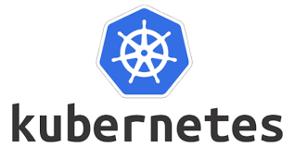
kubernetes, also known as K8s, is an open source system for automating deployment, scaling, and management of containerized applications.
It groups containers that make up an application into logical units for easy management and discovery.
Kubernetes builds upon 15 years of experience of running production workloads at Google, combined with best-of-breed ideas and practices from the community.

Slide 8

Maven is a build automation tool used primarily for Java projects.
Maven can also be used to build and manage projects written in C#, Ruby, Scala, and other languages.
The Maven project is hosted by The Apache Software Foundation,

